Slide 1
Computer Networks
Frank Walsh

Slide 2

Agenda (1st Part)
Computer Network Components
Device Types
Protocols
Topologies
Internet of Things

Slide 3

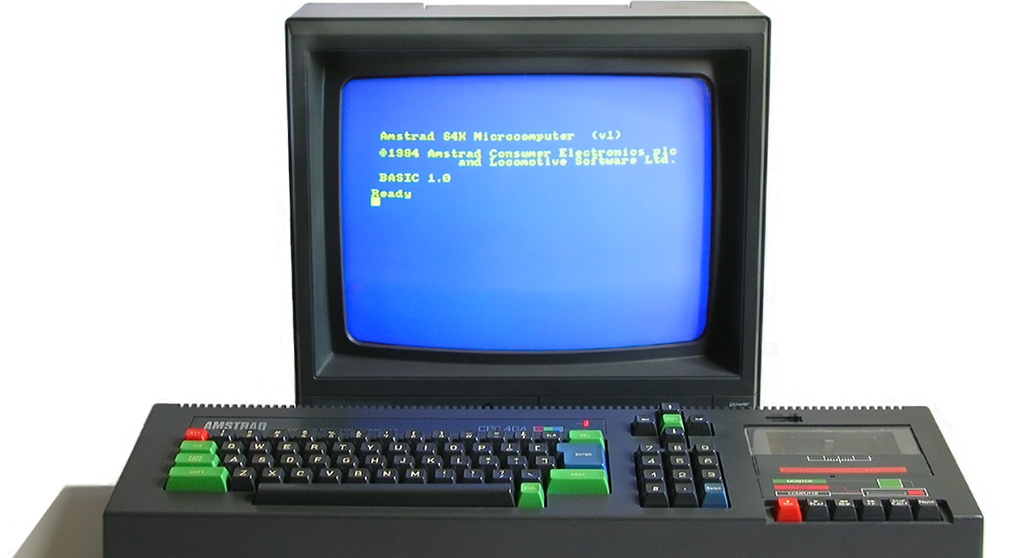
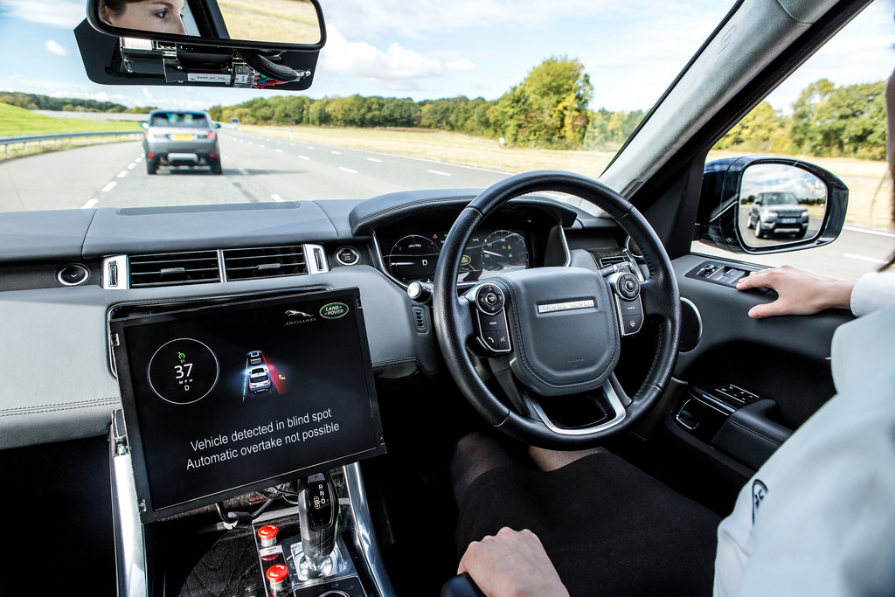
Networks
Computers, Devices & Machines are effective/beautiful in isolation...
Connecting machine/ device to a computer network creates amazing possibilities...
Key point:
Computer networks are no longer only used to connect computers
Part of many aspects of everyday life
Notes:
Going back a few decades, machines worked in isolation. Cars originally were very electromechanical. Could be thought of as information islands.
Jump forward to today – everything is getting connected, not just computers, but pretty much anything you can think of. Example in modern cars – connect to roadside infrastrure and other cars. Autonamous. Also can react to events (sensors in cars can detect impact/orientation

Slide 4
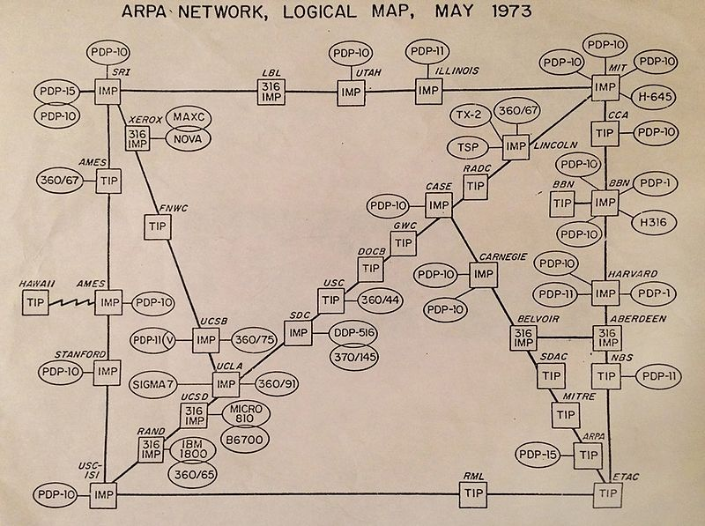
QI: Arpanet
US government responds to launch of Sputnik by setting up ARPA, the Advanced Research Projects Agency
ARPANET created in 1969 connecting computers in UCLA and Stanford
In 1973, it was called the "internetwork" or "internet" for short

Slide 5

QI: How heavy is the internet (data)?
It about the same as a grain of sand...
"In terms of data, if every bit of information stored in silicon comprises 40,000 electrons, the total weight of all the information flowing across the internet – books, music, photographs, emails, orders – is two millionths of an ounce"
Source: http://discovermagazine.com/2007/jun/how-much-does-the-internet-weigh

Slide 6
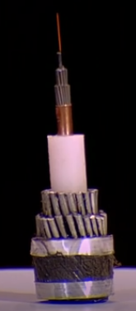

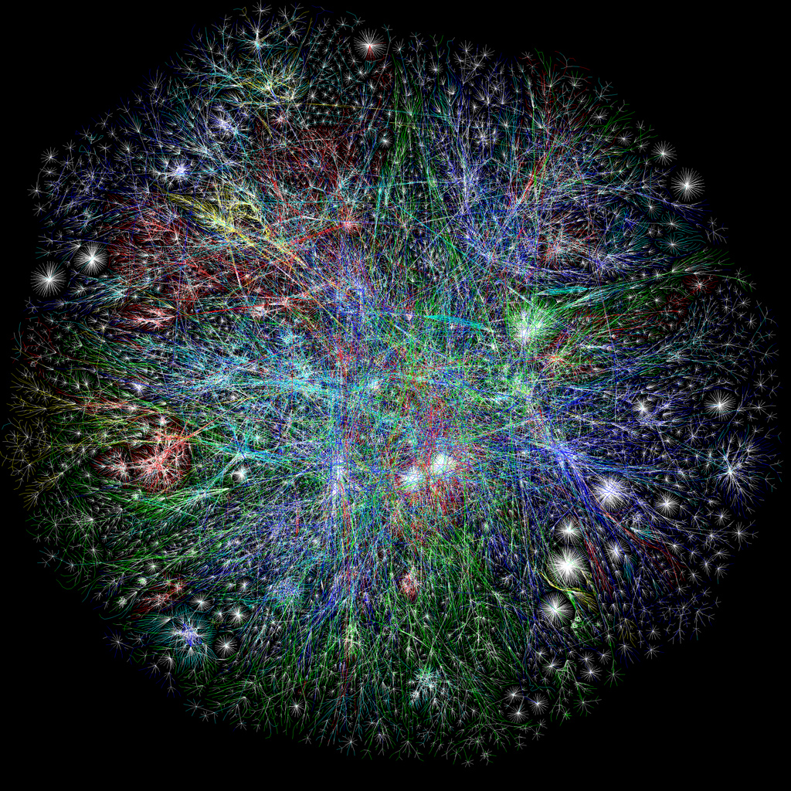

Networks - Under the bonnet
Inherently Physical:
Devices need some form of physical channel to communicate
Devices need specific hardware to use that channel (eg. antenna and associated electronics)
Notes:
Set of rpotocols that have cnaged everything.
Despite the number of devices, the physical nature if the internet has not changed that much: Lay fibre optic cables in pretty much the same way since the telegraph wires
More networks of the internet connect together.

Slide 7

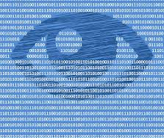
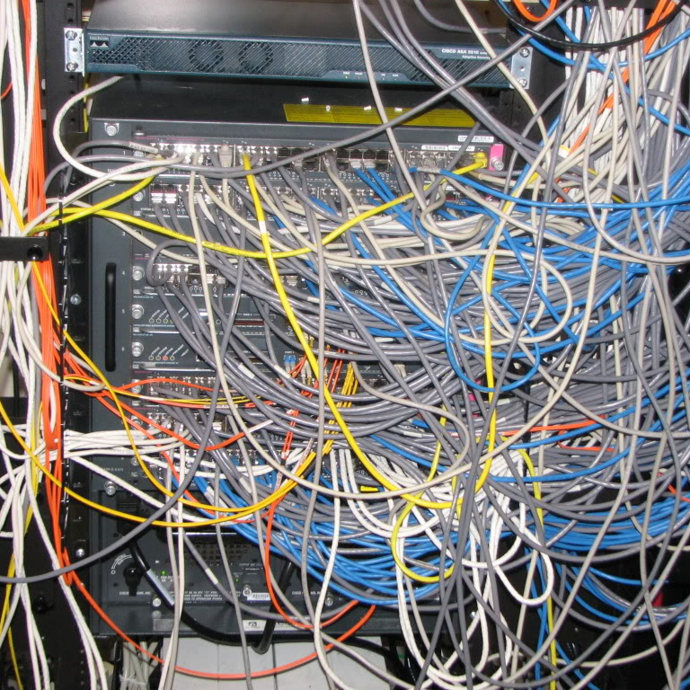
Networks – Under the bonnet
Once connected, it can get complicated!
Sophisticated combination of protocols, software, hardware, algorithms, configurations, policies...
Security, privacy, access, quality of service, wired/wireless...

Slide 8
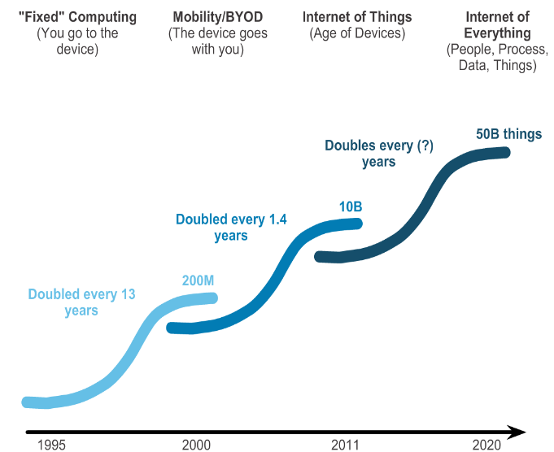
Computer Networks Evolution
Notes:
80s – isolates
90s – fixed
00s – laptops
10s – IoT
20s - IoE
Despite

Slide 9
Components of a Computer Network
Devices
Communicate with one another
Physical Medium
Used to connect devices
Messages
Information travelling over the medium
Rules
Governs how messages flow through a network

Slide 10
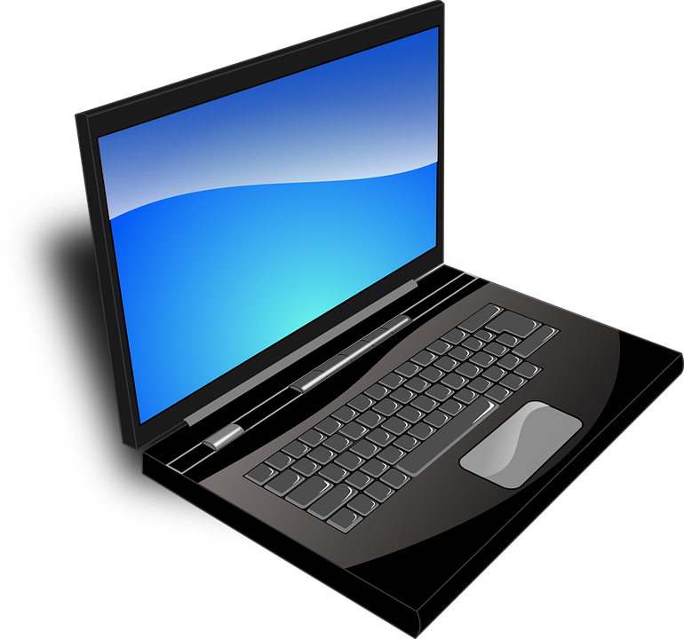

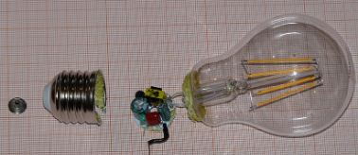
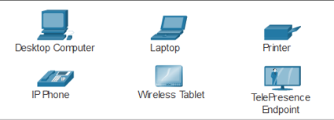
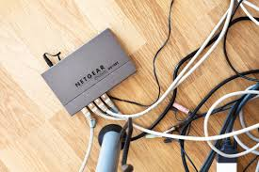
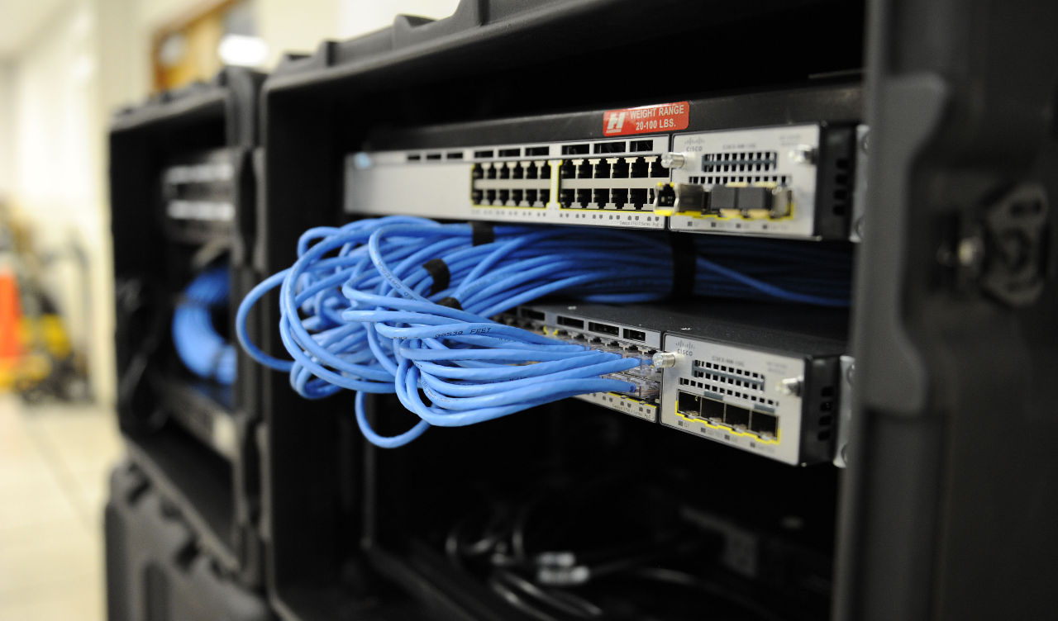
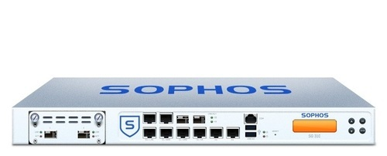

Device Types
End Devices
Infrastructure/intermediary Devices

Slide 11
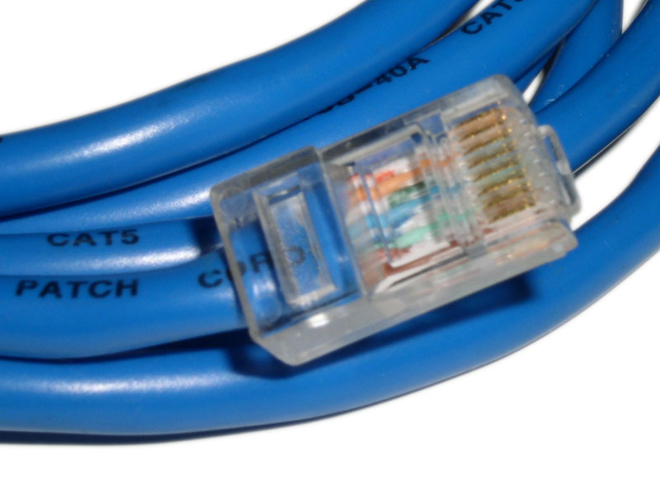
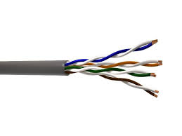
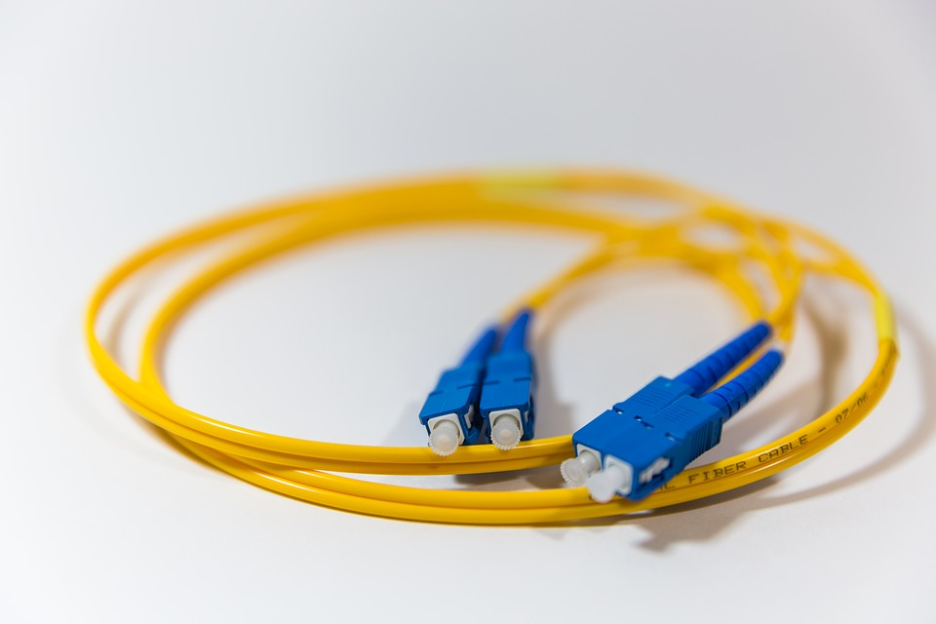
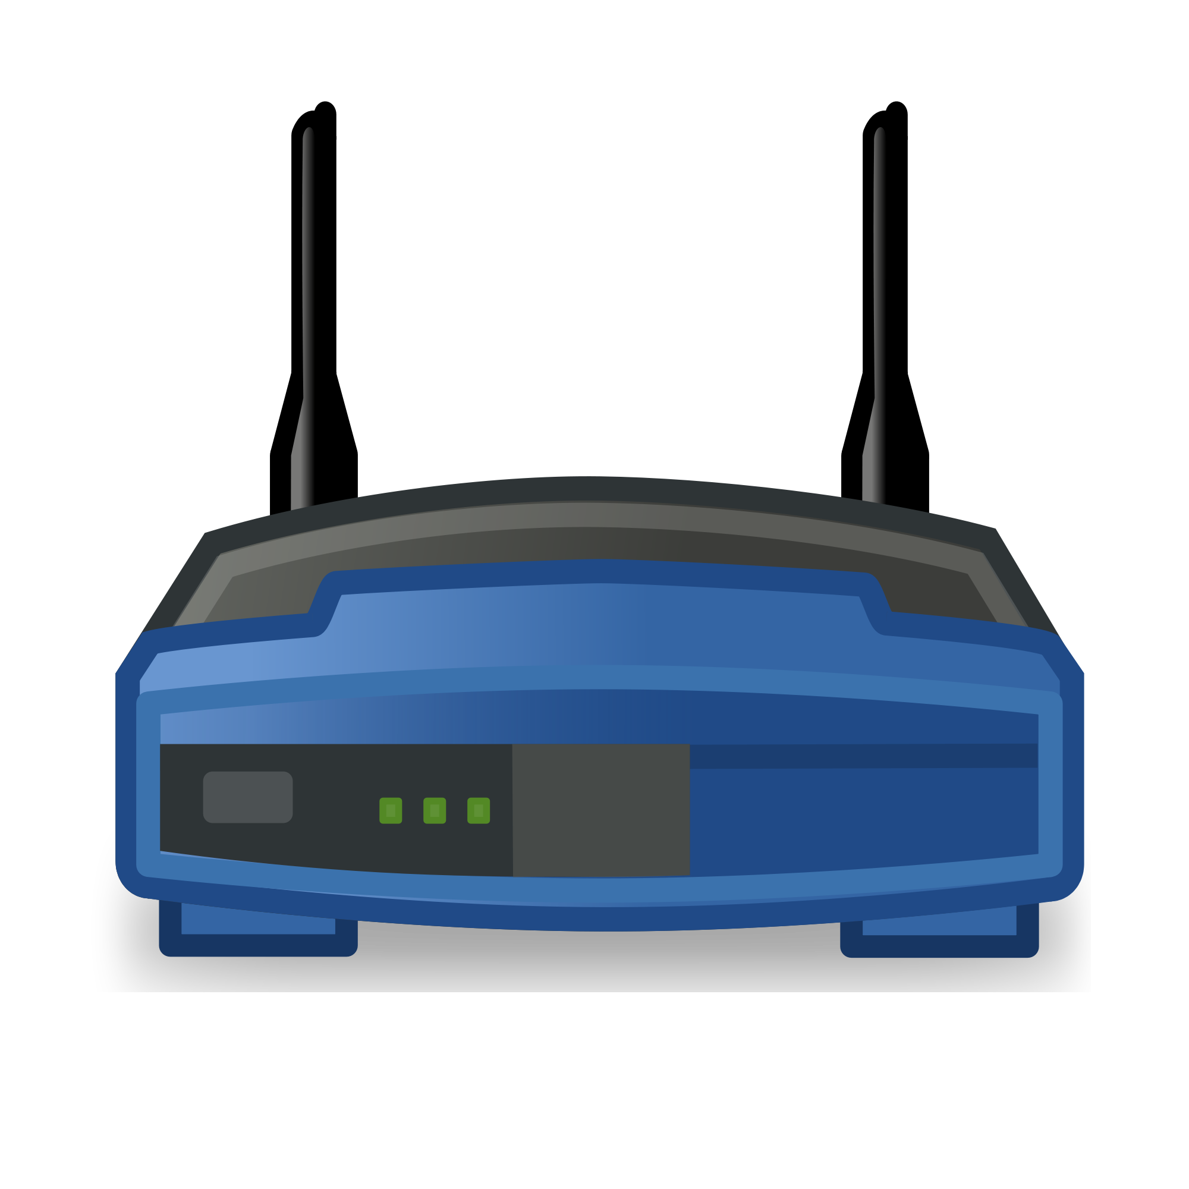
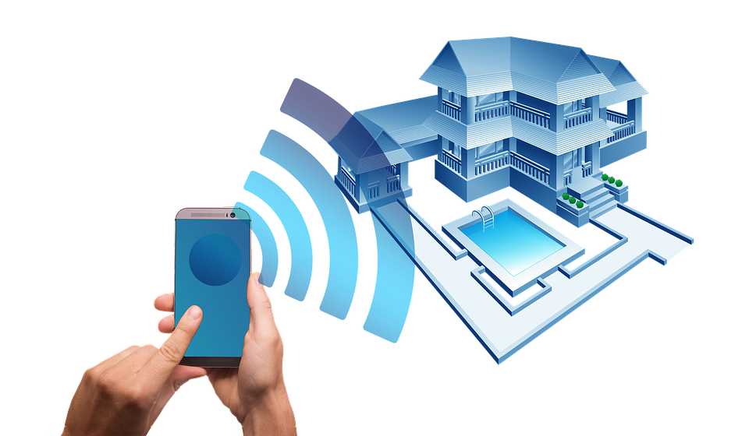
Physical Medium
Wired
Wireless

Slide 12
Messages
Data is divided into smaller parts during transmission
Segmentation
The benefits of doing so:
Many different conversations can be interleaved on the network(multiplexing)
Increases reliability of network communications.
The separate pieces of each message need not travel the same pathway across the network from source to destination
Adds complexity however:
Addressing, labeling, sending, receiving.
Reassembling
NEED RULES FOR THIS...
Application Data
Segment
Segment
Segment
Header
Segment

Slide 13

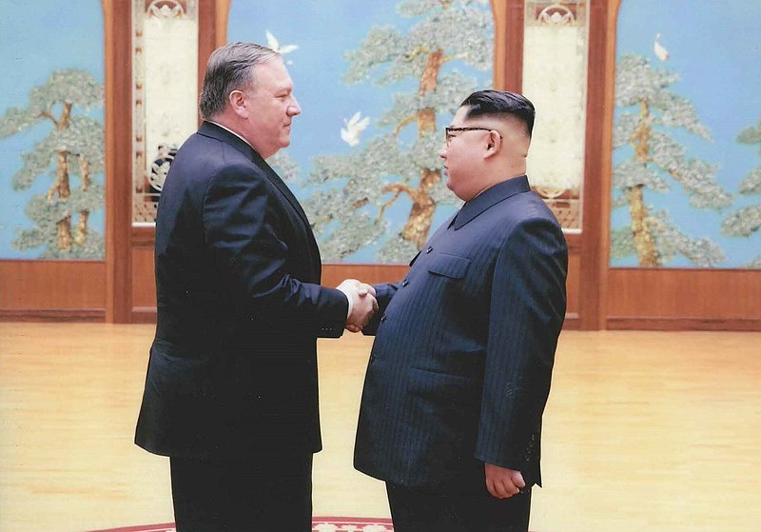
Rules
Humans have generally accepted protocols for interaction:
Identified sender and receiver
Agreed upon method of communicating (face-to-face, telephone...)
Common language and grammar
Speed and timing of delivery
Confirmation or acknowledgement requirements
All communication activity on the Internet is governed by protocols

Slide 14
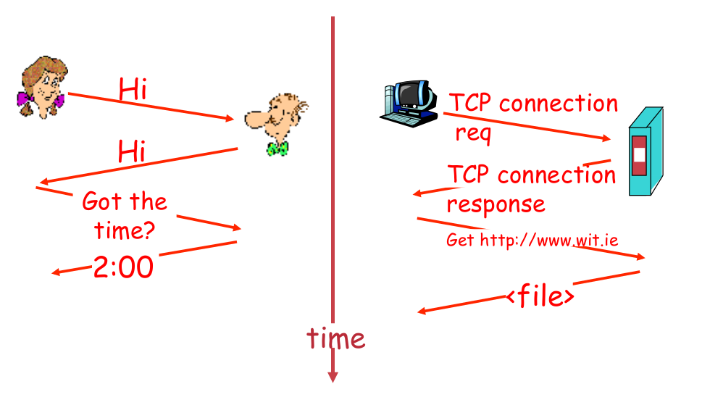
Human Protocol
Network Protocol

Slide 15
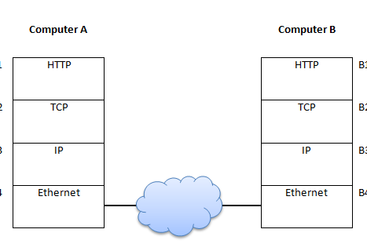
Network Protocols
Machines rather than humans
All communication activity in Internet governed by protocols
Protocols define
Format, order of msgs sent and received among network entities
Actions taken on msg transmission, receipt

Slide 16
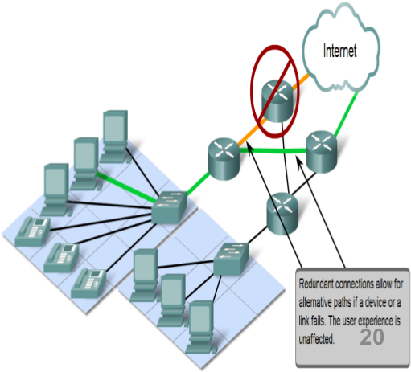
Network Characteristics
Network architecture refers to:
the technologies that support the infrastructure
The programmed services and protocols that move the messages across that infrastructure
4 general characteristics to meet user expectations
Fault tolerance
Scalability
Quality of service (QoS)
Security

Slide 17
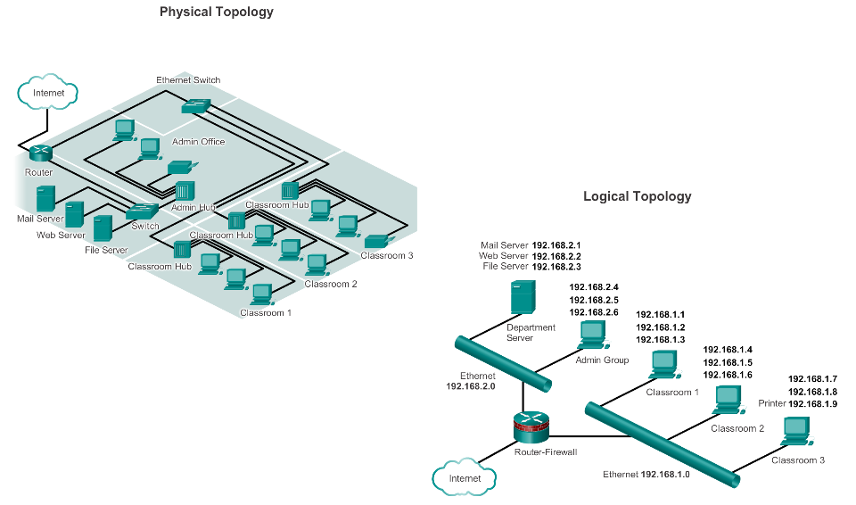
Network Topology and Representations
Network diagrams, often called topology diagrams, use symbols to represent devices within the network.
Physical topology diagrams illustrate the physical location of intermediary devices and cable installation.
Logical topology diagrams illustrate devices, ports, and the addressing scheme of the network.
Notes:
Physical topology diagrams illustrate the physical location of intermediary devices and cable installation.
Logical topology diagrams illustrate devices, ports, and the addressing scheme of the network.

Slide 18
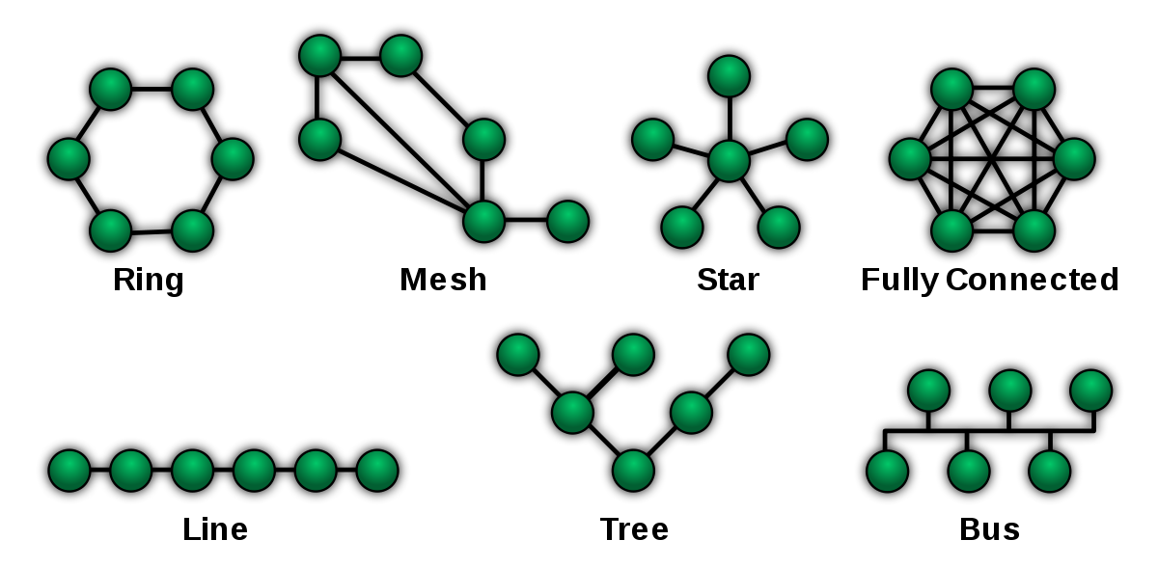
Network Topology
What connection to use? Unorganised….
Centre is single point of failure
Will not scale well
2 devices communicate simultaneously???
What if one device goes down???

Slide 19
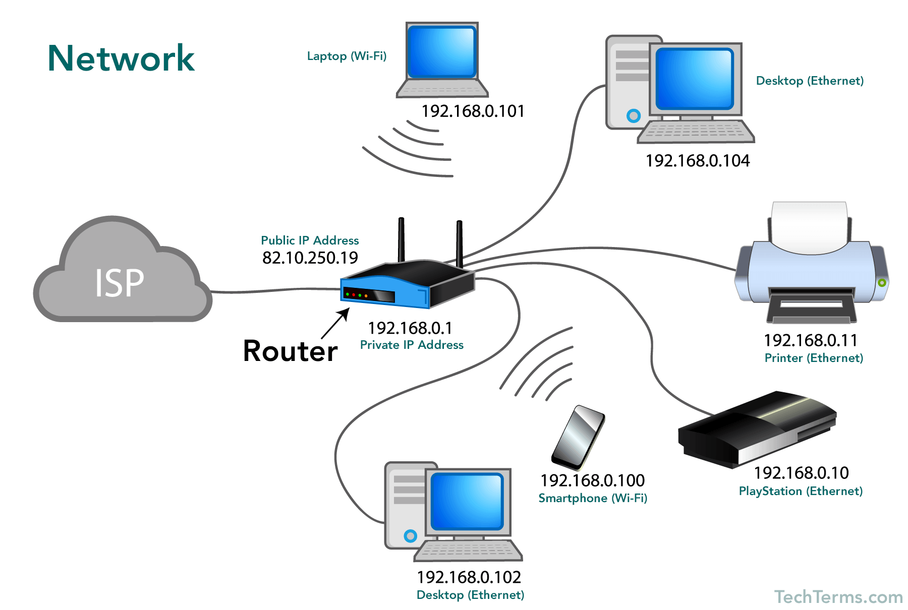
Typical Home Network
Source: https://techterms.com/definition/network

Slide 20
Some Networking Vocabulary
Network Interface Card/Adapter: any kind of interface to networking hardware. (e.g. wifi interface and wired interface). A network interface may be associated with a physical device, or it may be a representation of a virtual interface. (e.g. interfaces on your virtual machines)
LAN: Local Area Network refers to a network or a portion of a network that is not publicly accessible to the greater internet.
WAN: Wide Area Network. Much Larger and extensive than a LAN. Often used to refer to the Internet, as a whole.
Node: General term usually for a device on a network. Every node has a unique network address.
Media Access Control(MAC) address: Used to distinguish specific devices. A unique address that each device is assigned during manufacturing. Used to differentiates it from every other device on the internet. Typically, each network interface has a MAC address.
IP: protocols that allow the internet to work. IP addresses are unique on each network and they allow machines to address each other across networks.

Slide 21
Key Points so far
Networks are everywhere
4 Components of every network
Devices
Medium
Protocols (Rules)
Messages (Data)
Networks are connecting everything (not just for PCs/Laptops)
Networks have a Topology
Some key characteristics of a network
Fault tolerance
Scalability
Quality of service (QoS)
Security

Slide 22
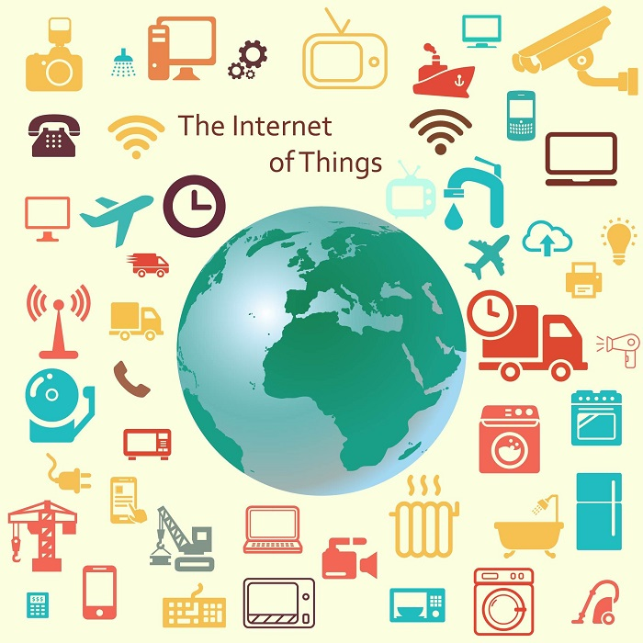
Internet of Things
Internet → The worldwide network of interconnected computer networks, based on standard communication protocols (TCP/IP).
Thing → An object not precisely identifiable.
Internet of Things (IoT) → A worldwide network of interconnected objects uniquely addressable, based on standard communication protocol.

Slide 23
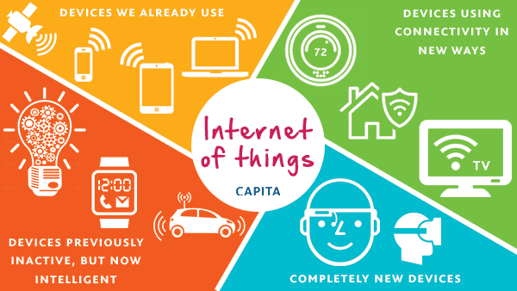
What’s the difference…
Extending the current Internet and providing connection, communication, and inter-networking between devices and physical objects, or "Things,“ (even biological things!)
https://www.capitatranslationinterpreting.com/the-internet-of-things/

Slide 24
IoT Evolution
Started with connectivity among people for sharing information.
Led to a “flat-world” where everyone across the world is connected.
Advancement in cloud computing and immersive experience led towards universal accessibility of data.
Combination of immersive experiences, connectivity and advancement in electronics further leading to Internet of Everything (IoE)
Source: Cisco

Slide 25
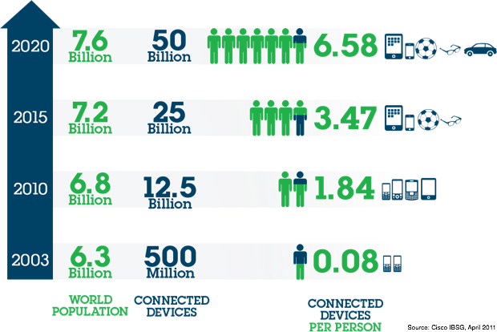
IoT Potential
Conservatively → 20 billion newly connected devices will be deployed.
First public website went live at CERN in 1990.
It took 15 years to reach 1 billion people on earth over the internet.
IoT is looking to add 6 billion connected devices per year.
Economic impact
New revenue streams
Reducing costs
Reducing time to market
Improving supply chain
Reducing production loss
Increasing productivity

Slide 26
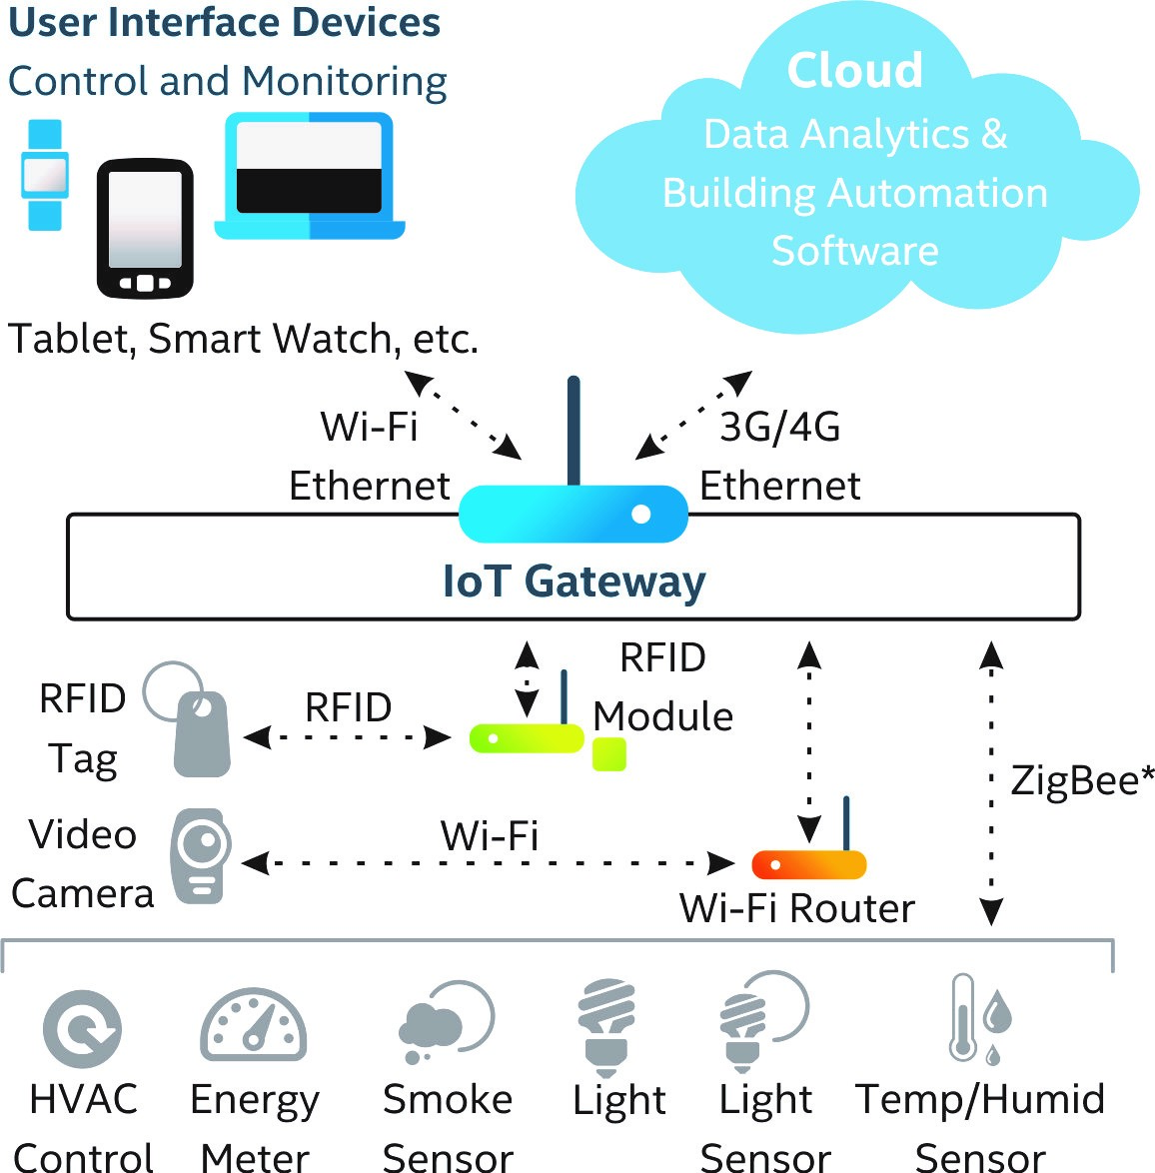
Building Blocks of an IoT System
Sensing
Connectivity
Gateways
Processing
Software
Power

Slide 27
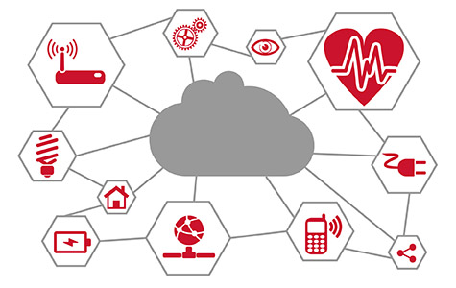
Networking and IoT
The Roles of Networks
Managing connected devices (discovery, join, leave, etc).
Relaying data packets from the source to the destination node in the network.
IoT is a distributed system. All nodes need to perform networking related tasks.
Main concerns as before: Reliability, Performance, Security, QOS, Scalability
http://www.psemi.com/markets/industrial/internet-of-things

Slide 28
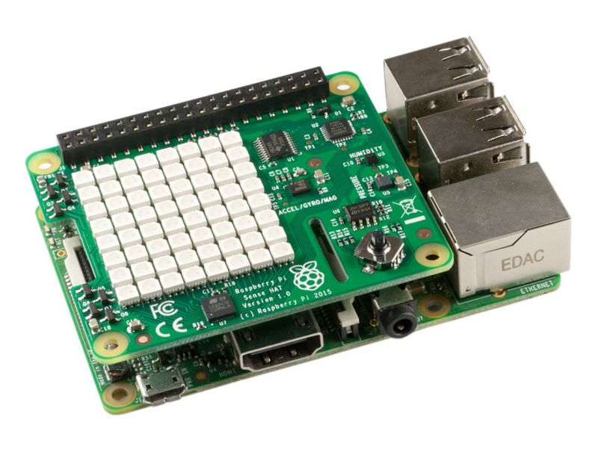
Learning about Networks/IoT
Can't create complex networks at home however you can simulate "virtual networks"
Virtualbox hypervisor
Packet Tracer
Can use programmable, multi-channel, prototyping device to investigate different mediums, protocols, IoT etc.
Raspberry Pi has bluetooth, Wifi, Ethernet, SPI, I2C...

Slide 29
Break

Slide 30
TCP/IP Model and Protocols

Slide 31
Agenda (2nd Part)
What’s a protocol suite/stack
TCP/IP and the benefits of “Layered Model”
Data Encapsulation
Accessing resources/data on a network
Logical addresses and Data Link (physical) addresses

Slide 32

Computer Network Protocols
An agreed convention for communication
Formally Defined and unambiguous
Network Protocols define:
Format
Message order
Actions on transmission/receipt

Slide 33
Protocol Suites & Standards
A Protocol Suite is a group of protocols designed to work together
Typically use open, widely used protocols.
Example: Wifi, HTTP, FTP, TCP, IP...
Protocol Standards established by Standards Organistations: Institute of Electrical and Electronics Engineers (IEEE) or the Internet Engineering Task Force (IETF)
Protocol suites based on open standards ensures that products from different manufacturers can work together for efficient communications

Slide 34
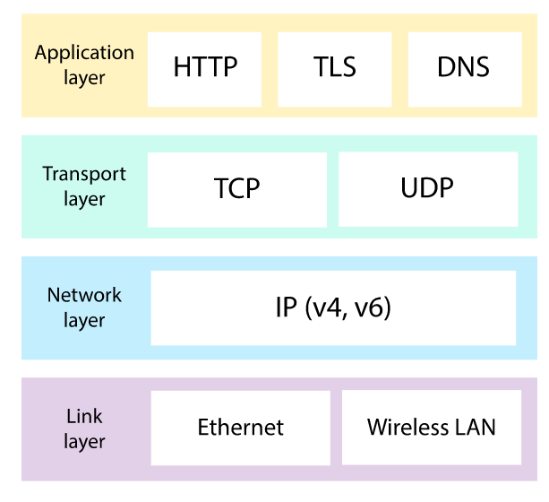
TCP/IP Protocol Suite
Often referred to as TCP/IP, TCPIP, or just IP
A whole suite of protocols, including TCP, IP, UDP, ARP, DNS, HTTP, ICMP and many more acronyms!
TCP originally developed by the US Department of Defense for wartime comms.
Remember ARPA
TCP/IP is now the “standard” protocol suite for the internet

Slide 35
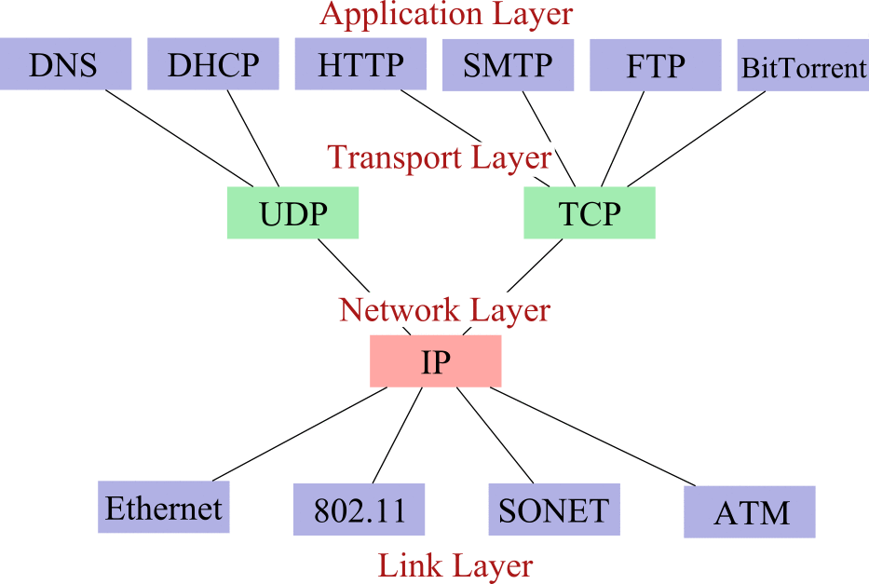

Slide 36
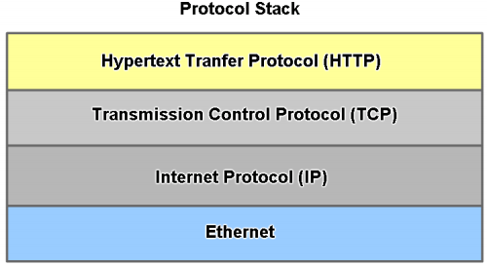
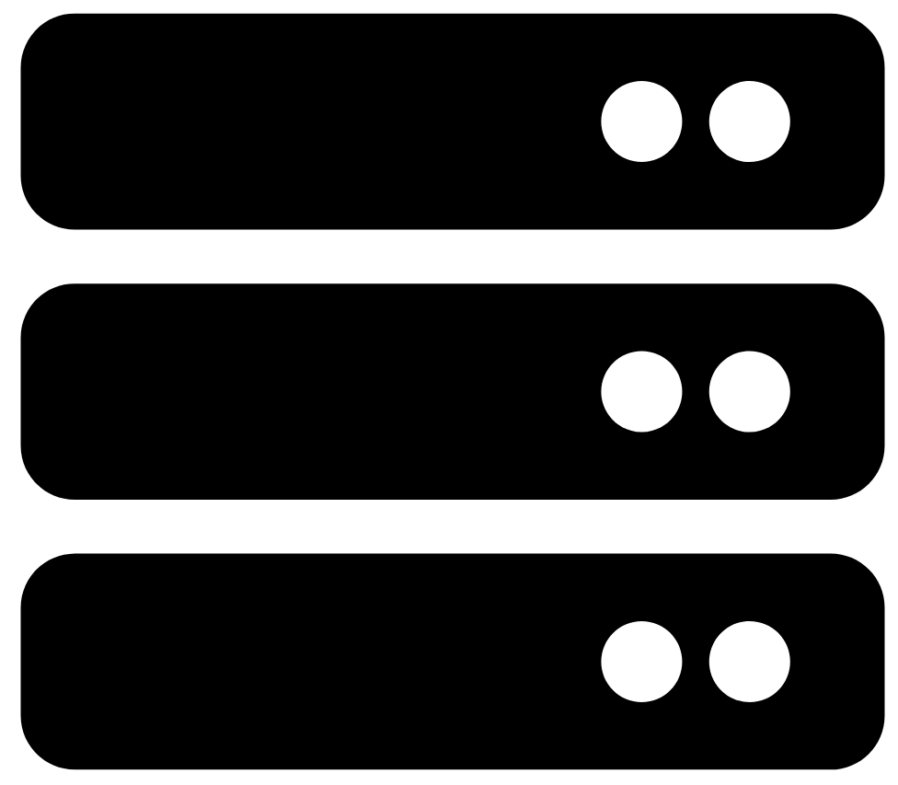
Example: Layered Model Network Comms
Web Server(Wired connection)
Layers
Application
Transport
Network
Data Link/ Physical
Benefits of Layered Model:
assists in protocol design
fosters competition
changes in one layer do not affect other layers
provides a common language

Slide 37
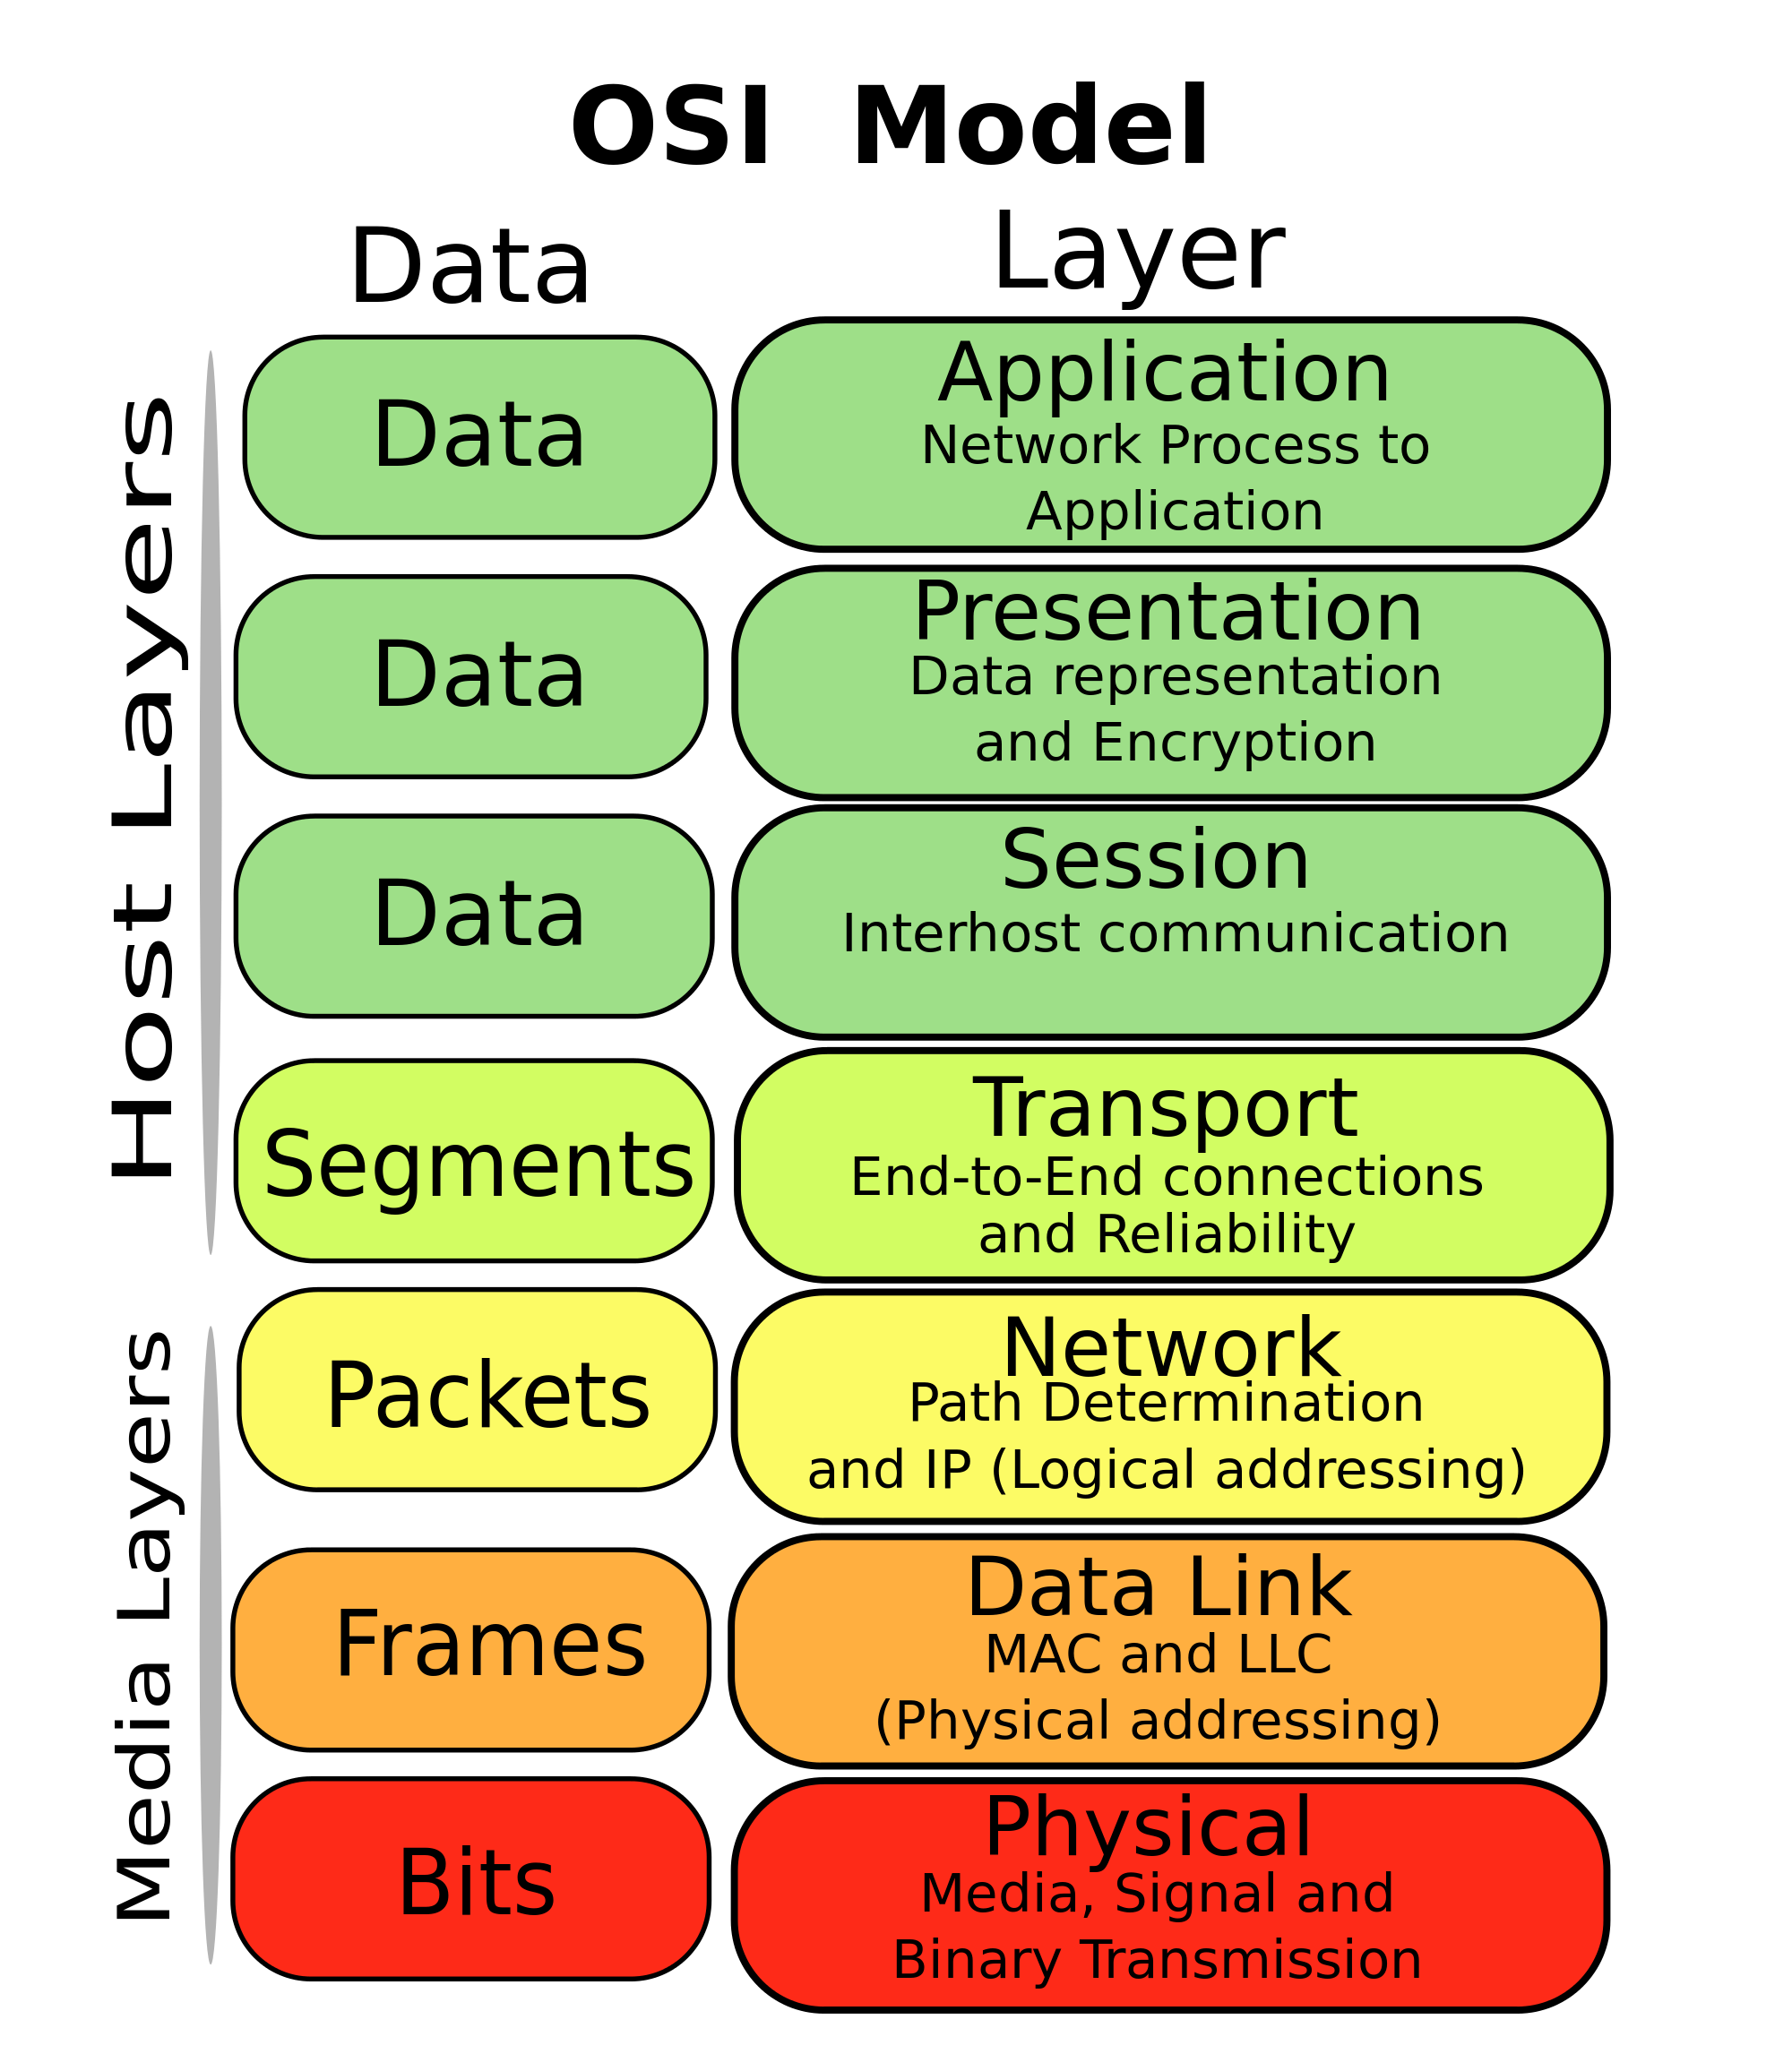
OSI Model
Open Systems Interconnection(OSI) introduced by the International Organization for Standardization (ISO) in 1984
Provide a reference model to make sure products of different vendors would interoperate in networks.
A layer in the OSI model communicates with three other layers:
the layer above it, the layer below it, and the same layer at its communication partner.
Image Source: https://upload.wikimedia.org/wikipedia/commons/thumb/4/47/Osi-model-jb.svg/2000px-Osi-model-jb.svg.png

Slide 38
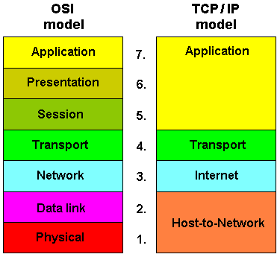
OSI vs TCP/IP
TCP/IP model combines the presentation and session layer into its application layer.
TCP/IP combines the OSI data link and physical layers into the host-to-network/network access layer
Internet developed on around TCP/IP protocols.
Thus very popular.... Networks are not usually built on the OSI model, even though the OSI model is used as a guide.
(Data Link/Physical)

Slide 39


Comms in TCP/IP: Data Encapsulation
Large File
Data
Data
Data
User Data
Segment Header
Data
TCP Segment
Network Header
Segment Header
Data
IP Packet
Frame Header
Network Header
Segment Header
Data
Frame Trailer
Ethernet Frame
(Data Link/Physical)
010001010101010011111010100111011011100101010101110….
Notes:
Encapsulation is the process where protocols add their information to the data.
At each stage of the process, a PDU has a different name to reflect its new functions.
There is no universal naming convention for PDUs, in this course, the PDUs are named according to the protocols of the TCP/IP suite.
PDUs passing down the stack are as follows:
Data (Data Stream)
Segment
Packet
Frame
Bits (Bit Stream)

Slide 40
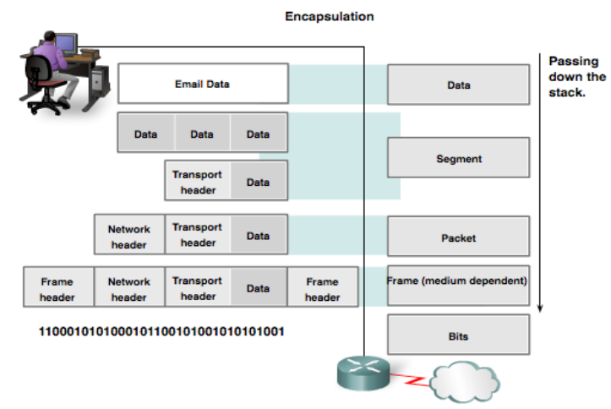
Data Encapsulation: Protocol Data Units (PDUs)
Image: cisco.com

Slide 41
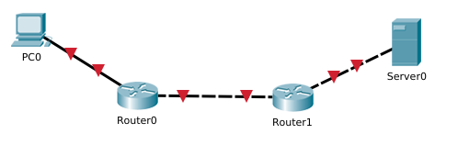
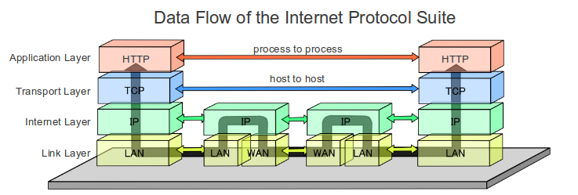
Layered Model: From A to B across the internet
This Photo by Unknown Author is licensed under CC BY-SA

Slide 42
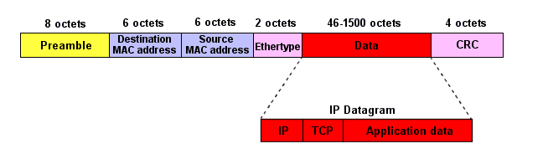
Data Link (Layer 2) Communication
Ethernet Frame
moving of data into and out of a physical link in a network.
Ethernet/Wifi
Supported by many physical layer implementations
PDU is the frame
Sequence of alternating 1s and 0s for synchronisation
Unique 6 octet (48 bit) address. “hardware” or “physical” address
Value used to check accidental changes to raw data. Calculated at both ends using data. Received value should match calculated value…

Slide 43
Network Layer Communication
Network layer protocols primary function is to move data from one network to another network
Network addresses(IP Addresses) must have a mechanism to locate hosts on different networks
Intermediary network devices such as routers, decapsulate frames to read destination host address contained in the packet header.
Routers use the network portion of this address to determine which path to use to reach its destination.
IP/Network Packet
Destination IP Address
Source IP Address
Data
Network
Device
Network
Device

Slide 44
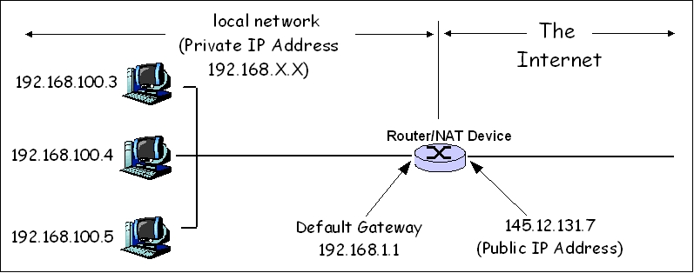
Network Layer Communication
IP addresses are “logical”
Can be assigned to a device
Includes network identification and Host identification
Each device on a network must have a unique IP address
Public IP addresses for the internet assigned by a central authority (IANA)
Private IP addresses are reserve for internal use behind routers/Network address translation(NAT) devices.
This Photo by Unknown Author is licensed under CC BY-SA

Slide 45
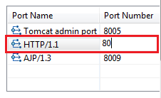
Transport Layer Communication
How does a computer with one network interface differentiate between different services?
Port Numbers are used in the transport layer to represent applications or services
When a device receives data, the port number is used to determine which app or process is the correct destination
There are generally accepted port numbers:
What’s the port for SSH service?
HTTP service?
FTP service?
This Photo by Unknown Author is licensed under CC BY-SA

Slide 46
Accessing Resources on a network
TCP/IP Protocol Suite

Slide 47
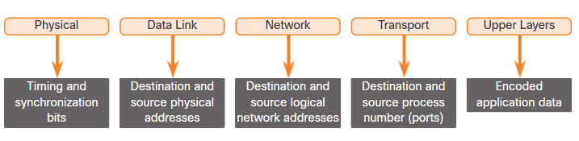
Addressing
Network layer source and destination addresses
Used to deliver an IP packet from original source to the final destination.
Data link layer source and destination
Used to deliver the data link frame from one network interface card (NIC) to another NIC on the same network.
Notes:
3 – Protocols and Models
3.7 – Data Access
3.7.1 – Addresses

Slide 48
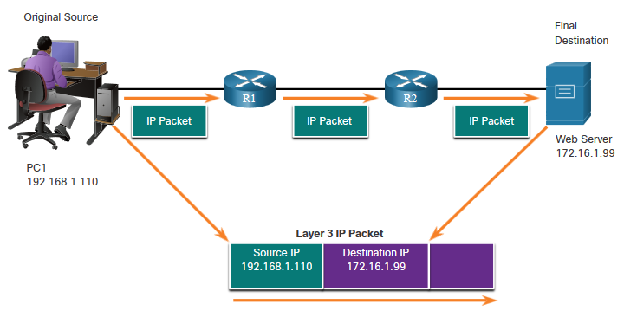
Network Layer: Logical Address
The IP packet contains two IP addresses:
Source IP address - The IP address of the sending device, original source of the packet.
Destination IP address - The IP address of the receiving device, final destination of the packet.
These addresses may be on the same link/network or remote.
IP Packet
Notes:
3 – Protocols and Models
3.7 – Data Access
3.7.2 – Layer 3 Logical Address

Slide 49
Network Layer Logical Address (Cont.)
An IP address contains two parts:
Network portion
The left-most part of the address indicates the network group which the IP address is a member.
Each LAN or WAN will have the same network portion.
Host portion
identifies a specific device within the group. The remaining part of the address
This portion is unique for each device on the network.
IP Packet
Notes:
3 – Protocols and Models
3.7 – Data Access
3.7.2 – Layer 3 Logical Address (Cont.)

Slide 50
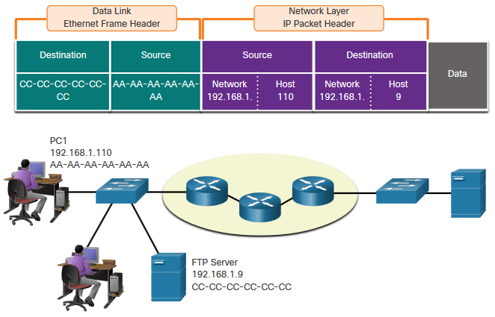
Devices on the Same Network
When devices are on the same network the source and destination will have the same number in network portion of the address.
PC1 – 192.168.1.110
FTP Server – 192.168.1.9
Notes:
3 – Protocols and Models
3.7 – Data Access
3.7.3 – Devices on the Same Network-

Slide 51
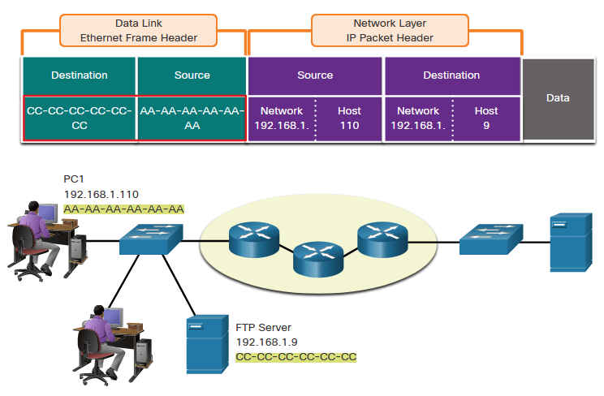
Data Link Layer Addresses: Same IP Network
When devices are on the same Ethernet network the data link frame will use the actual MAC address of the destination NIC.
MAC addresses are physically embedded into the Ethernet NIC and are local addressing.
The Source MAC address will be that of the originator on the link.
The Destination MAC address will always be on the same link as the source, even if the ultimate destination is remote.
Notes:
3 – Protocols and Models
3.7 – Data Access
3.7.4 – Role of the Data Link Layer Addresses: Same IP Network

Slide 52
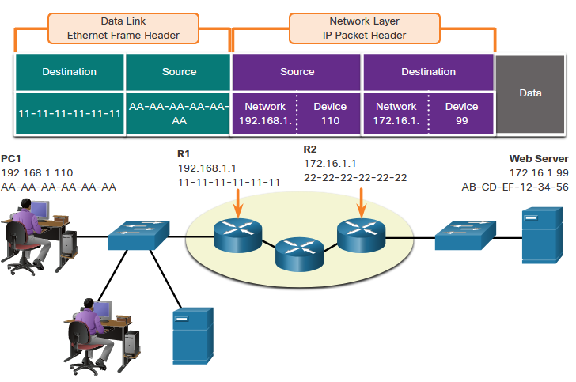
Devices on a Remote Network
What happens when the actual (ultimate) destination is not on the same LAN and is remote?
What happens when PC1 tries to reach the Web Server?
Does this impact the network and data link layers?
Notes:
3 – Protocols and Models
3.7 – Data Access
3.7.5 – Devices on a Remote Network

Slide 53
Role of the Network Layer Addresses
When the source and destination have a different network portion, this means they are on different networks.
PC1 – 192.168.1
Web Server – 172.16.1
Notes:
3 – Protocols and Models
3.7 – Data Access
3.7.6 – Role of the Network Layer Addresses

Slide 54
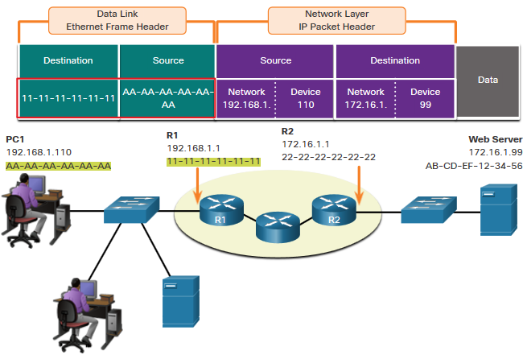
Role of the Data Link Layer Addresses: Different IP Networks
When the final destination is remote, Layer 3 will provide Layer 2 with the local default gateway IP address, also known as the router address.
The default gateway (DGW) is the router interface IP address that is part of this LAN and will be the “door” or “gateway” to all other remote locations.
All devices on the LAN must be told about this address or their traffic will be confined to the LAN only.
Once Layer 2 on PC1 forwards to the default gateway (Router), the router then can start the routing process of getting the information to actual destination.
Notes:
3 – Protocols and Models
3.7 – Data Access
3.7.7 – Role of the Data Link Layer Addresses: Different IP Networks

Slide 55
Role of the Data Link Layer Addresses: Different IP Networks (Cont.)
The data link addressing is local addressing so it will have a source and destination for each link.
The MAC addressing for the first segment is :
Source – AA-AA-AA-AA-AA-AA (PC1) Sends the frame.
Destination – 11-11-11-11-11-11 (R1- Default Gateway MAC) Receives the frame.
Note: While the L2 local addressing will change from link to link or hop to hop, the L3 addressing remains the same.
Notes:
3 – Protocols and Models
3.7 – Data Access
3.7.7 – Role of the Data Link Layer Addresses: Different IP Networks (Cont.)

Slide 56

Data Link Addresses
Since data link addressing is local addressing, it will have a source and destination for each segment or hop of the journey to the destination.
The MAC addressing for the first segment is:
Source – (PC1 NIC) sends frame
Destination – (First Router- DGW interface) receives frame
Notes:
3 – Protocols and Models
3.7 – Data Access
3.7.8 – Data Link Addresses

Slide 57

Data Link Addresses (Cont.)
The MAC addressing for the second hop is:
Source – (First Router- exit interface) sends frame
Destination – (Second Router) receives frame
Notes:
3 – Protocols and Models
3.7 – Data Access
3.7.8 – Data Link Addresses (Cont.)

Slide 58

Data Link Addresses (Cont.)
The MAC addressing for the last segment is:
Source – (Second Router- exit interface) sends frame
Destination – (Web Server NIC) receives frame
Notes:
3 – Protocols and Models
3.7 – Data Access
3.7.8 – Data Link Addresses (Cont.)

Slide 59
Data Access Data Link Addresses (Cont.)
Notice that the packet is not modified, but the frame is changed, therefore the L3 IP addressing does not change from segment to segment like the L2 MAC addressing.
The L3 addressing remains the same since it is global and the ultimate destination is still the Web Server.
Notes:
3 – Protocols and Models
3.7 – Data Access
3.7.8 – Data Link Addresses (Cont.)

Slide 60
Summary
Networking Layered Model:
TCP/IP (4 layer) and OSI (7 layer) models. We’ll concentrate on TCP/IP
TCP/IP protocol suite encapsulation
Data referred to a protocol data units (PDU)
5 different PDUs: data, segment, packet, frame, bits
Accessing Data
Addressing provided at Network and Data Link Layers
Network Layer: IP addressing (Logical)
Data Link: MAC addressing (Physical)
Provides addressing solution for accessing resources on the same network or different network/

